Slide 1
Transportation Problem (TP)

Slide 2
1. Transportation Problem (TP)
Distributing any commodity from any group of supply centers, called sources, to any group of receiving centers, called destinations, in such a way as to minimize the total distribution cost (shipping cost).

Slide 3
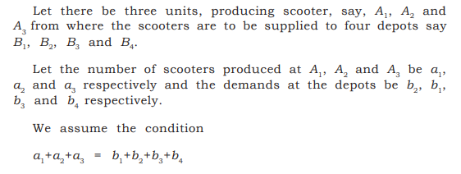

Mathematical Formulation of TP

Slide 4
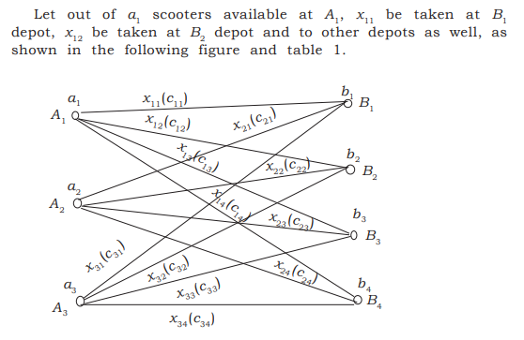

Slide 5
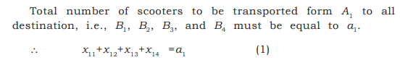
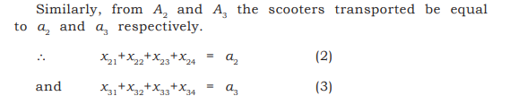

Slide 6
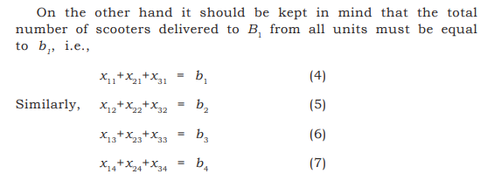

Slide 7
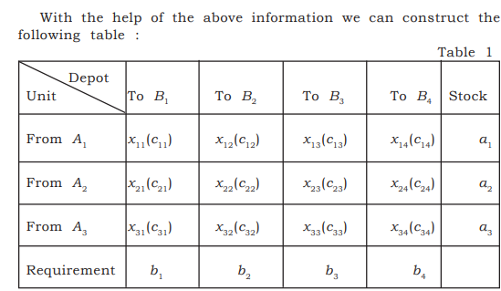

Slide 8
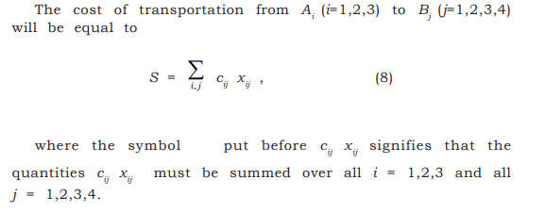
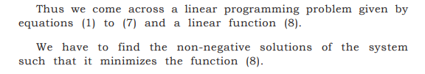

Slide 9
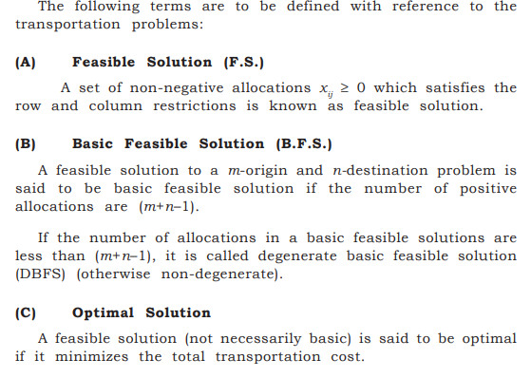

Slide 10
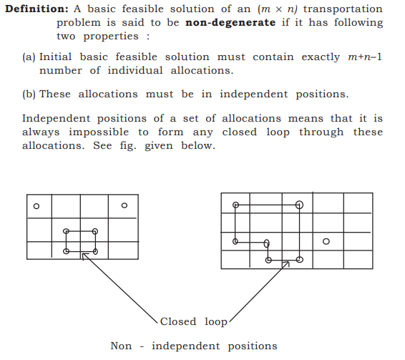

Slide 11
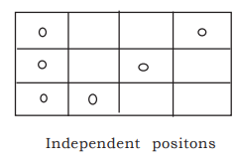

Slide 12
Definitions: Balanced and Unbalanced TP
If total supply equal to total demand, the TP is said to be Balanced. Otherwise, it is called as Unbalanced TP.
Transformation from Unbalanced to Balanced TP
If total supply exceeds total demand, a dummy destination, whose demand equals the difference between the total supply and total demand is created. Similarly if total supply is less than total demand, a dummy source is created, whose supply
equals the difference.
All unit shipping costs into a dummy destination or out of a dummy source are 0.

Slide 13
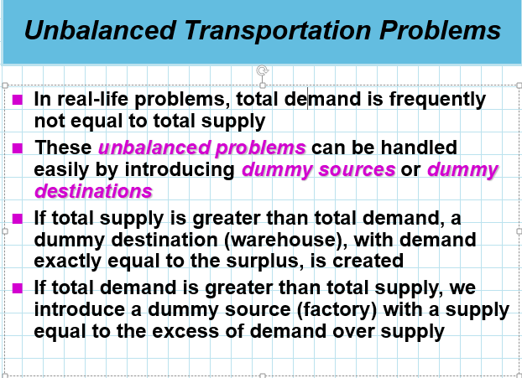

Slide 14
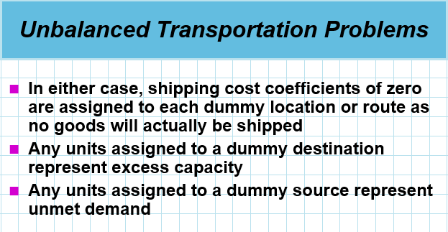

Slide 15
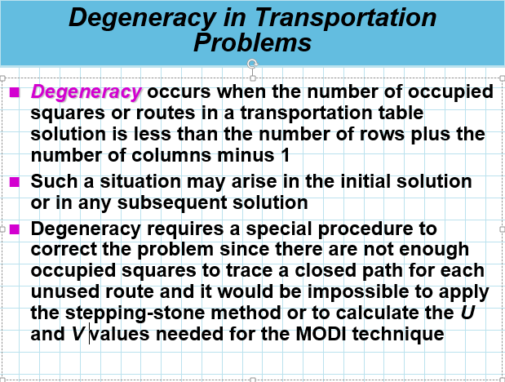

Slide 16
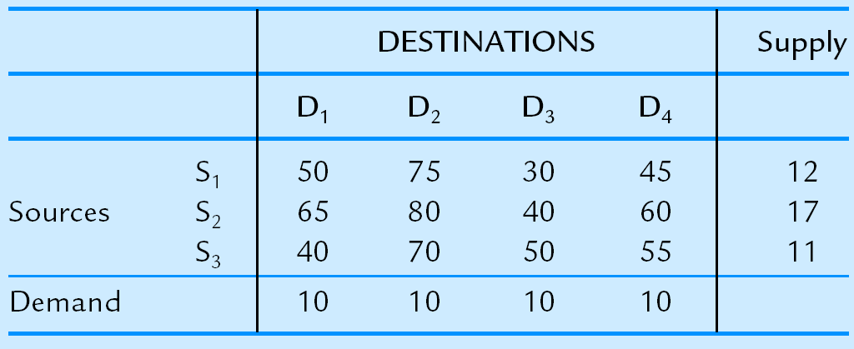
Example : Balanced TP

Slide 17
Example :Unbalanced TP
 |  | Destination |  |  | Supply
 | D1 | D2 | D3 | D4
S1 | 50 | 75 | 35 | 75 | 12
Source S2 | 65 | 80 | 60 | 65 | 17
S3 | 40 | 70 | 45 | 55 | 11
(D) | 0 | 0 | 0 | 0 | 10
Demand | 15 | 10 | 15 | 10

Slide 18
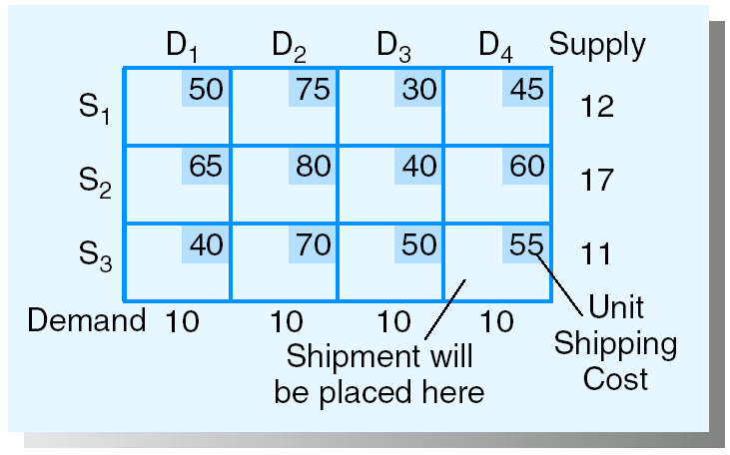
Transportation Tableau:

Slide 19
Initial Solution Procedure:
1. Northwest Corner Starting Procedure
1. Select the remaining variable in the upper left (northwest) corner and note the supply remaining in the row, s, and the demand remaining in the column, d.
2. Allocate the minimum of s or d to this variable. If this minimum is s, eliminate all variables in its row from future consideration and reduce the demand in its column by s; if the minimum is d, eliminate all variables in the column from future consideration and reduce the supply in its row by d.
REPEAT THESE STEPS UNTIL ALL SUPPLIES HAVE BEEN ALLOCATED.

Slide 20
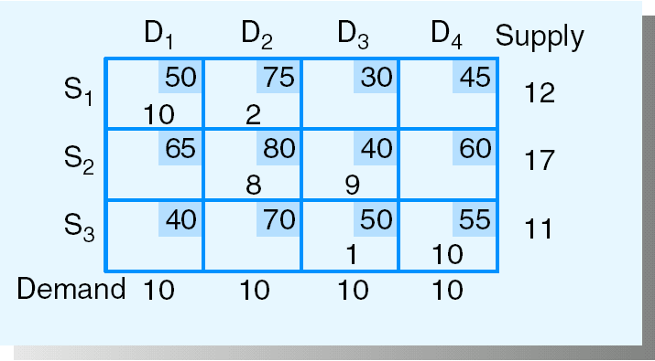
Total sipping cost = 2250

Slide 21
2. Least Cost Starting Procedure
1. For the remaining variable with the lowest unit cost, determine the remaining supply left in its row, s, and the remaining demand left in its column, d (break ties arbitrarily).
2. Allocate the minimum of s or d to this variable. If this minimum is s, eliminate all variables in its row from future consideration and reduce the demand in its column by s; if the minimum is d, eliminate all variables in the column from future consideration and reduce the supply in its row by d.
REPEAT THESE STEPS UNTIL ALL SUPPLIES HAVE BEEN ALLOCATED.

Slide 22
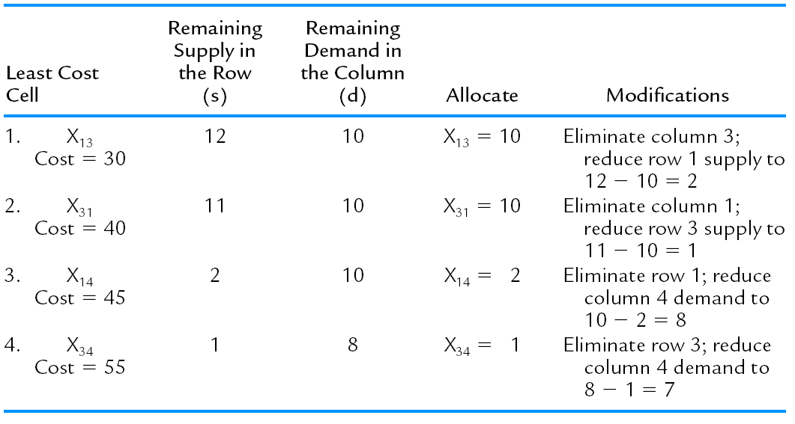

Slide 23
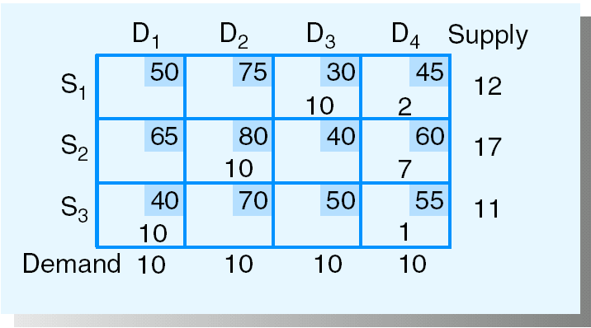
Total sipping cost = 2065

Slide 24
3. Vogel’s Approximation Method Starting Procedure
1. For each remaining row and column, determine the difference between the lowest two remaining costs; these are called the row and column penalties.
2. Select the row or column with the largest penalty found in step 1 and note the supply remaining for its row, s, and the demand remaining in its column, d.
3. Allocate the minimum of s or d to the variable in the selected row or column with the lowest remaining unit cost. If this minimum is s, eliminate all variables in its row from future consideration and reduce the demand in its column by s; if the minimum is d, eliminate all variables in the column from future consideration and reduce the supply in its row by d.
REPEAT THESE STEPS UNTIL ALL SUPPLIES HAVE BEEN ALLOCATED.

Slide 25
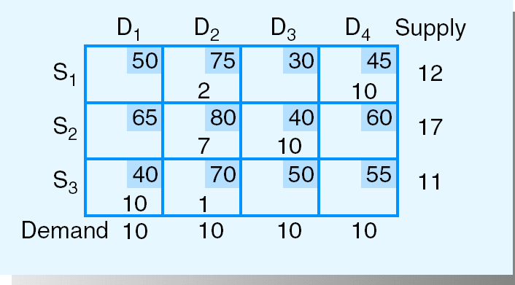
Total sipping cost = 2030

Slide 26
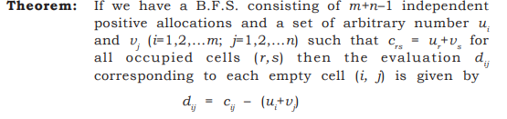
Modified Distribution Method (MODI Method)
(OR)
U-V Method

Slide 27
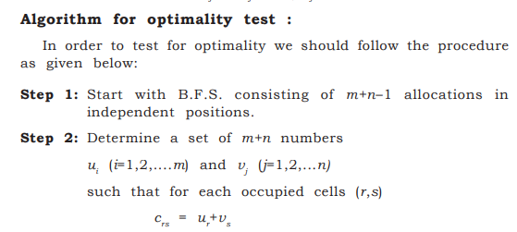

Slide 28
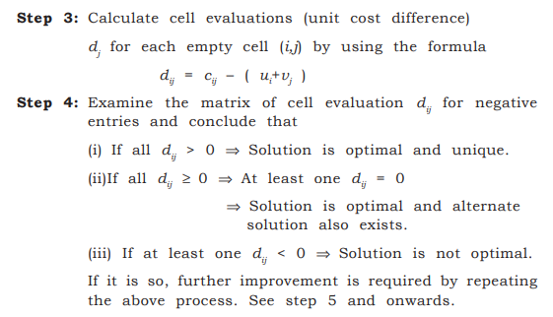

Slide 29
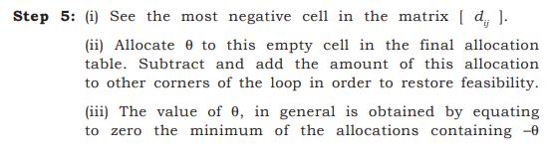
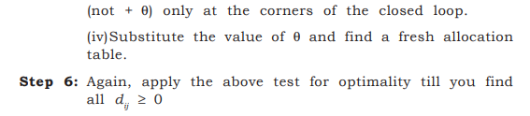

Slide 30
Step 1: Determine the C_{ij}–Z_{ij} Values for the Nonbasic Variables
1. If U_{i} is the dual variable associated with the i-th supply constraint, and V_{j} is the dual variable associated with the j-th demand constraint, then for shipments from node i to node j, one can find the corresponding Z_{ij} value by Z_{ij} = U_{i} + V_{j}. Thus the C_{ij}–Z_{ij} value for variable X_{ij} is found by
C_{ij} - Z_{ij} = C_{ij} - (U_{i} + V_{j}) = C_{ij} - U_{i} - V_{j}

Slide 31
2. Given that there is a redundant equation among the m +n constraints (and any of the m + n constraints can be considered the redundant one), one can show that the U_{i} or V_{j} associated with the redundant equation is 0. Thus one U_{i} or V_{j} can arbitrarily be selected and set to 0. Arbitrarily choose U₁ = 0.
3. Since the C_{ij}–Z_{ij} values for basic variables are 0 (i.e., C_{ij} – U_{i} - V_{j} = 0 for basic variables), we can easily solve for the remaining values of the U_{i}’s and V_{j}’s from the m + n - 1 equations for the basic variables.

Slide 32
4. Once the U_{i}’s and V_{j}’s have been determined, the C_{ij}–Z_{ij} values for the nonbasic variables can be calculated by
C_{ij} - Z_{ij} = C_{ij} - U_{i} - V_{j}
5. Choose the nonbasic variable with the most negative C_{ij}–Z_{ij} value as the entering variable. If all C_{ij}–Z_{ij} values are nonnegative, STOP; the current solution is optimal.

Slide 33
Step 2: Find the cycle that includes the entering variable and some of the BASIC variables. Alternating positive and negative changes on the cycle, determine the “change amount” as the smallest allocation on the cycle at which a subtraction will be made.
Step 3 : Modify the allocations to the variables of the cycle found in step 2 by the “change amount” and return to step 1.

Slide 34
Example 1 :
Total sipping cost = 2030

Slide 35
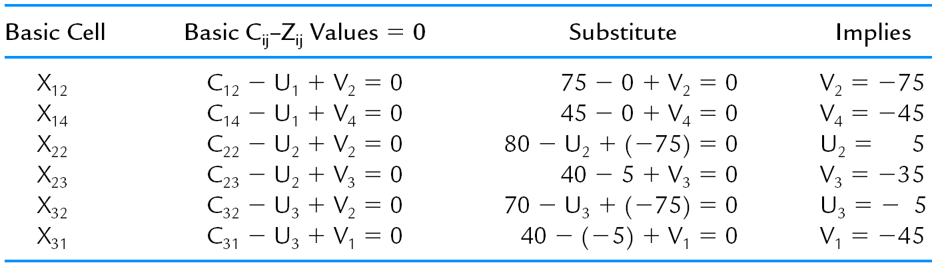

Slide 36
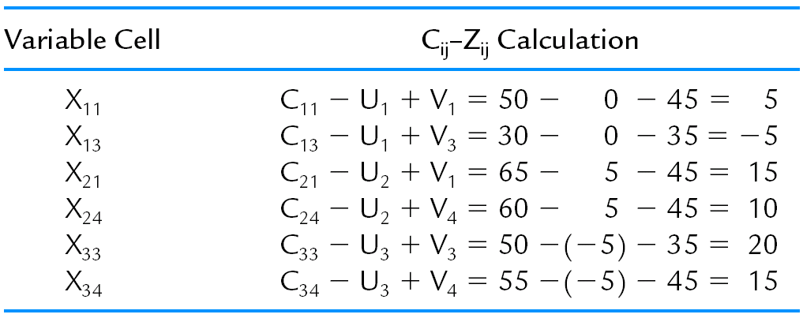
Non-basic cells:
Note: X₁₃ is the entering variable.

Slide 37
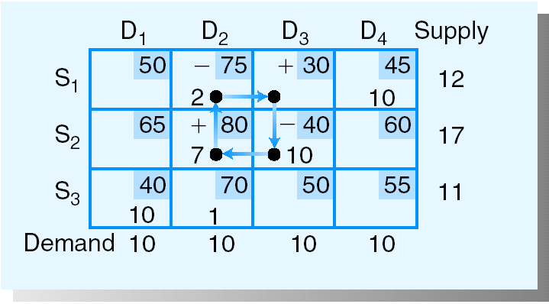
Step 2: Determine Which Current Basic Variable Reaches 0 First
Note: 1. Cycle property
2. X₁₂ is the leaving variable

Slide 38
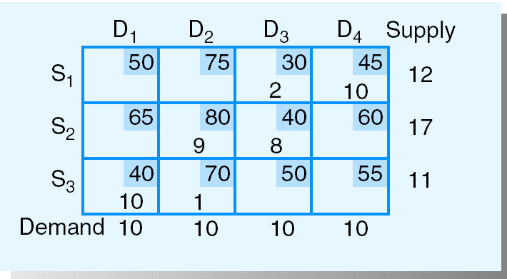
Step 3: Determine the Next Transportation Tableau
Total shipping cost = 2020
{Improvement = 2 (-5) = 10 }

Slide 39
Note: there must be m + n - 1 basic variables for the transportation simplex method to work!
=> Add dummy source or dummy destination, if necessary
(m=# of sources and n=# of destinations)

Slide 40
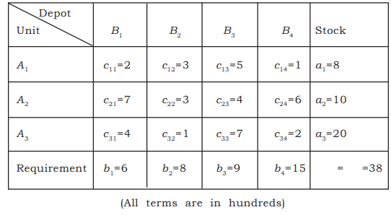
Example 2 :

Slide 41
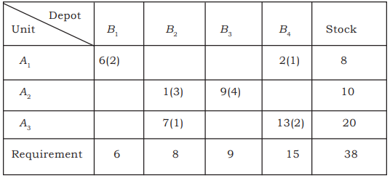
By VAM, the initial BFS is

Slide 42
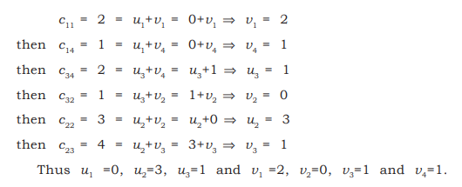

Slide 43
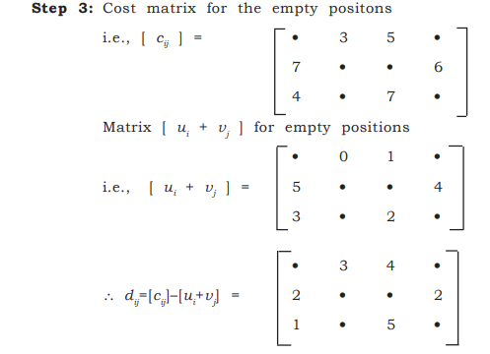


Slide 44
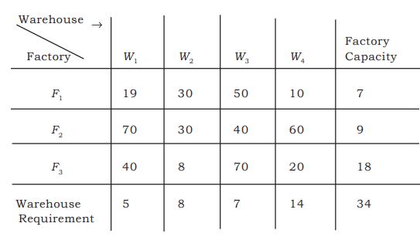

Slide 45
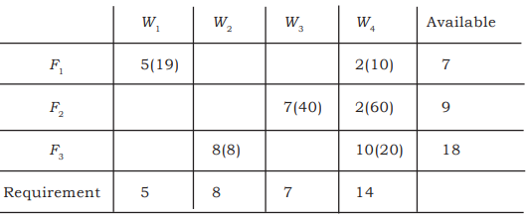

Slide 46
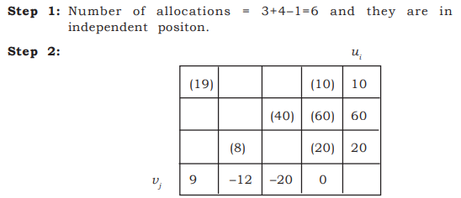

Slide 47
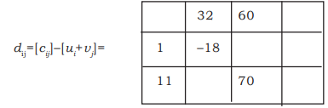


Slide 48
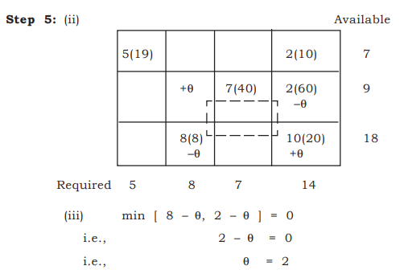

Slide 49
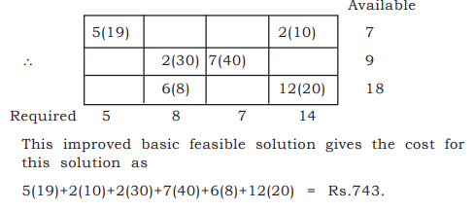

Slide 50
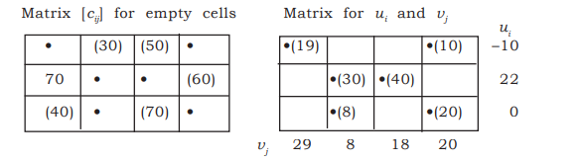

Slide 51
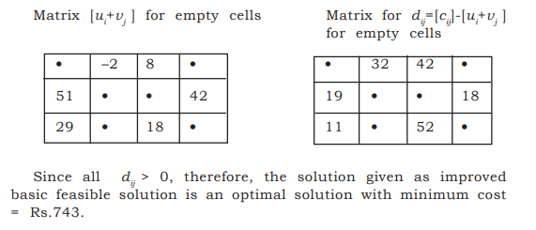

Slide 52
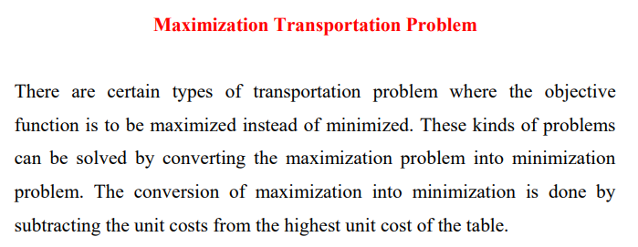

Slide 53
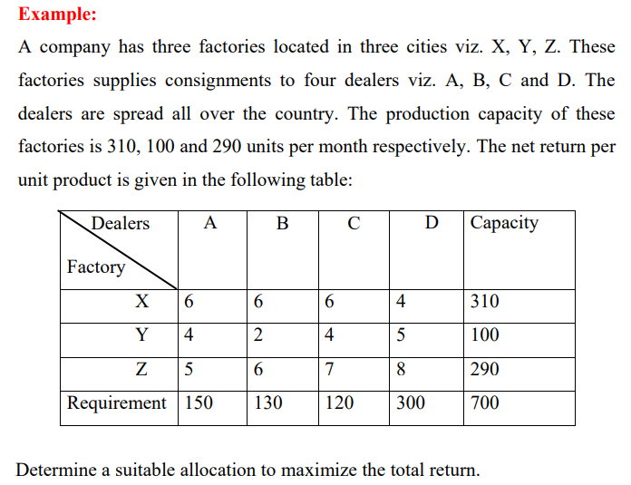

Slide 54
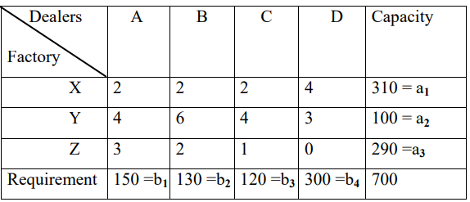
Minimization Problem

Slide 55

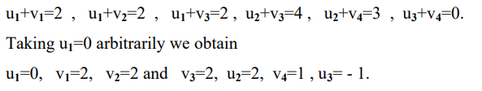

Slide 56
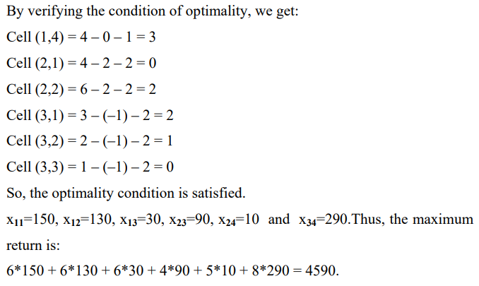

Slide 57
The Assignment Problem (AP)
An assignment problem is a special case of TP with m=n and s_{i}=d_{j} =1for all i and j. It arises because available resources have varying degrees of efficiency for performing different activities i.e cost, profit or time of performing the different activities is different. This type of problem where the main motive is to allot a number of origins to the equal number of destinations at a least cost are called assignment problems.

Slide 58
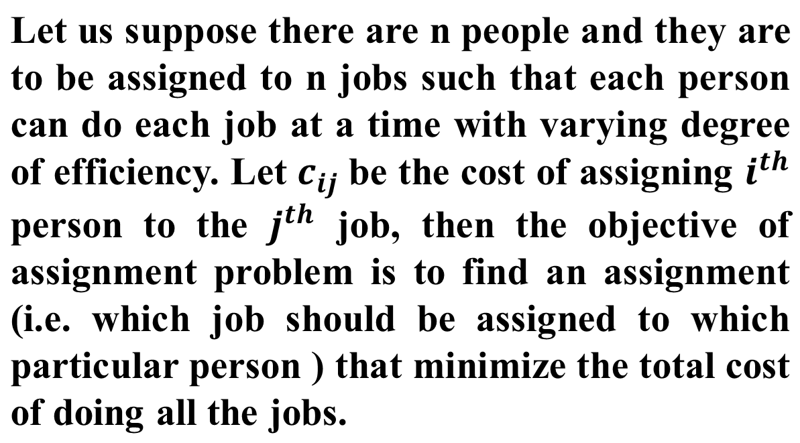

Slide 59
Assumptions:
1. There is a cost assignment matrix for the m “people” to be assigned to m “tasks.” (If necessary dummy rows or columns consisting of all 0’s are added so that the numbers of people and tasks are the same.)
2. All costs are nonnegative.
3. The problem is a minimization problem.

Slide 60
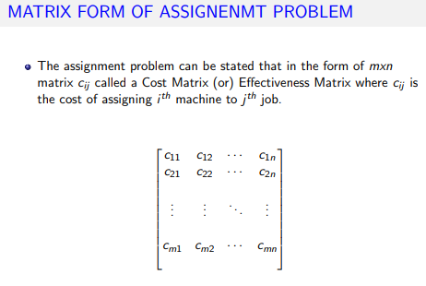

Slide 61
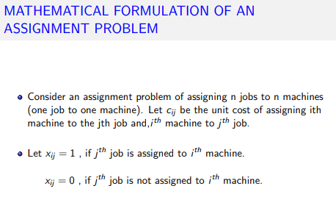

Slide 62
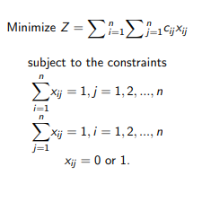

Slide 63


Slide 64

Difference between Transportation and Assignment Problem

Slide 65
Theorems on Assignment Problem
Theorem 1: Reduction Theorem
In an assignment problem, if a constant is added to or subtracted from every element of any row or column in the given cost matrix, an assignment that minimize the total cost in one matrix also minimize the total cost in the other matrix.

Slide 66


Slide 67
The Hungarian Algorithm for solving Assignment Problems
Working Procedure:
Step1 : Find the Opportunity Cost Table
i). For each row, subtract the minimum number from all numbers in that row.
ii). In the resulting matrix, subtract the minimum number in each column from all numbers in the column.

Slide 68
Step 2 : Determining the Maximum Number of Zero-Cost Assignments
Identify rows successively from top to bottom until a row with exactly one zero element is found. Make an assignment to this single zero by making a square ( ) around it and crossed off ( ) all other zeroes in the corresponding column.
Identify column successively from left to right with exactly one zero element that has not been assigned. Make assignment to the single zero by making a square ( ) around it and crossed – off ( ) all other zero elements in the corresponding rows.
If a row (or column) has two or more unmarked zeros and one cannot be chosen by inspection, then select the zero cell arbitrarily for assignment.
Repeat the above steps successively until all the zeroes have been examined.

Slide 69
Step 3: Optimality Check
If all zero elements in the matrix are either marked with square ( ) or cross – off ( ) and there is exactly one assignment in each row and column then it is an optimal solution. Here the total cost associated with this solution is obtained by adding original cost figures in the assigned cells.
If a zero element in a row or column was chosen arbitrarily for assignment in the above step(i), there exist an alternate optimal solution.
If there is no assignment in a row (or column) then it implies that the total number of assignments are less than the no. of rows (or columns) in the square matrix. In such cases go to the next step.

Slide 70
Step 4: Revision of Opportunity Cost Matrix
1. Mark all rows with no assignments (with a “‧”).
2. For each row just marked, mark each column that has a 0 in that row (with a “‧”).
3. For each column just marked, mark each row that has an assignment in that column (with a “‧”).
4. Repeat steps 2 and 3 until no more marks can be made.
5. Draw lines through unmarked rows and marked columns.

Slide 71
Step 5: Find the new revised opportunity cost matrix
Choose the smallest element (say m) among the cells not covered by any line.
Subtract m from every element in the cell not covered by a line
Add m to every element in the cell covered by two lines i.e. intersection of two lines.
Elements in cells covered by one line remains unchanged.
Step 6: Repeat steps 3 to 5 until an optimal solution is obtained.

Slide 72

Example:

Slide 73


Slide 74

Minimum uncovered
number

Slide 75

Minimum uncovered
number

Slide 76



Slide 77


Slide 78


Slide 79



Slide 80


